Slide 1



Phantom Gym
Website
Revolutionizing Fitness Online.

Slide 2
TEAM -- ID :
Mohamed Wessam -------- 231015089
Seif Eldeen Abdelrahman- 231006092
Ahmed Amr ------------------ 231006911
Youssef Mostafa ------------ 231005962
Supervised by: DOC. ALAA ELDKEN
02

Slide 3
04
INTRODUCTION:
Phantom Gym is a modern online platform designed to meet the needs of fitness enthusiasts. It offers:
A Membership page to explore and subscribe to plans.
Login and Registration for account management.
An engaging News & Events section.
An About Us page to build trust and connect with users.
This project aims to simplify gym operations and provide a seamless experience for users.

Slide 4

Scope :
Target Users:
Gym members and fitness enthusiasts
Gym owners and administrators
Why Phantom Gym?
With the growing importance of fitness and health, there is a need for an efficient and interactive online platform to manage gym memberships and connect with users.
Phantom Gym caters to these audiences by providing essential features to manage memberships and engage users effectively.

Slide 5
Login page
Sign up page
It allow the user to login to website to see his member ship and it connected with data base to see the validation ( to check if user already exists ).
If the user doesn’t exists to forward the user to make account it include ( Email , password , phone number , full name ).
Home page
Contact us page
It show the user the main interface of the website that leave him the option to navigate in website function and show him main buttons like (membership , news & events -> to see the news that the gym provide ) and “ Learn more “ button is to show the user more about the website
It a form page that helps the user to contact the for further question the form ask the user to enter his data to contact him ( name , phone number , email , subject , message ) and send message button
Membership page
Admin page
It show the user all gyms in “Cards” and every gym contains its location and its prices and subscribe to gym if he wants
It an admin page to help the owners to see data base and modify it and see how many users entered the website and see if anyone sent message ( contact us page )
06

Slide 6
Website logo :

Slide 7
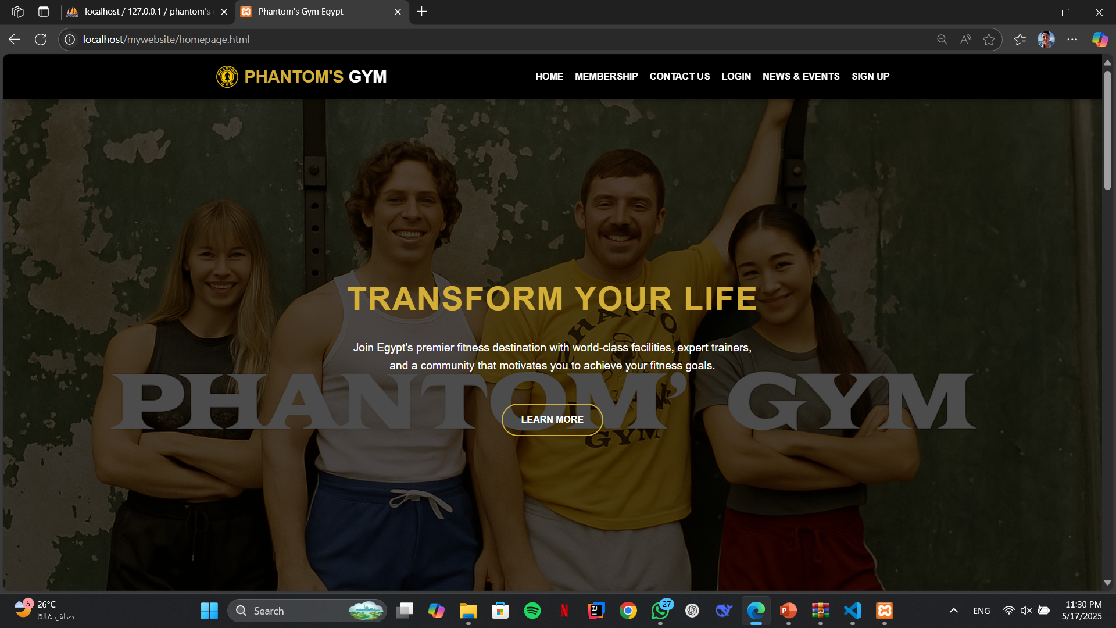
Vistors home page :
Product refers to the good or service you are offering to customers.
What needs does this product fulfil? What frustrations does it address? What makes it compelling to customers such that they will believe they need to have it?
Price
Price is what customers pay for a product or service and it takes into account the cost of production. What is the value of the product or service to customers? Are there established price points for this product or service in the market? How will this price compare with competitors?
Brand
Features
Packaging
Price
Discounts
Bundling deals
Credit terms
Promotion
Promotion is how you will get the word out about your product or service to your target customers.
It includes advertising, public relations, and promotional strategies.
Place
Place refers to how and where your customers will look to see your product or service. It also considers how you will deliver the product or service to them. Will it be in a physical store or online? What will be the distribution channels?
Ads
PR
Social Media
Email
Search Engine
Video
Stores
Website
Online
Marketplace
08

Slide 8
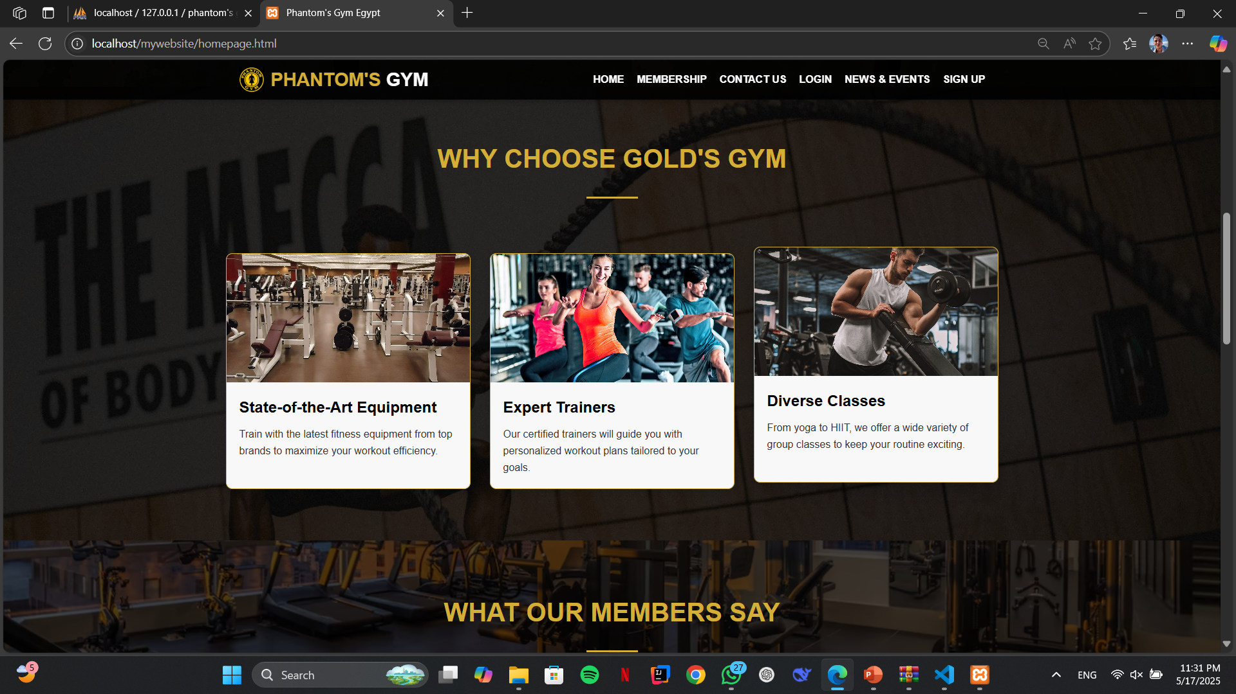
homepage :
Product refers to the good or service you are offering to customers.
What needs does this product fulfil? What frustrations does it address? What makes it compelling to customers such that they will believe they need to have it?
Price
Price is what customers pay for a product or service and it takes into account the cost of production. What is the value of the product or service to customers? Are there established price points for this product or service in the market? How will this price compare with competitors?
Brand
Features
Packaging
Price
Discounts
Bundling deals
Credit terms
Promotion
Promotion is how you will get the word out about your product or service to your target customers.
It includes advertising, public relations, and promotional strategies.
Place
Place refers to how and where your customers will look to see your product or service. It also considers how you will deliver the product or service to them. Will it be in a physical store or online? What will be the distribution channels?
Ads
PR
Social Media
Email
Search Engine
Video
Stores
Website
Online
Marketplace
08

Slide 9
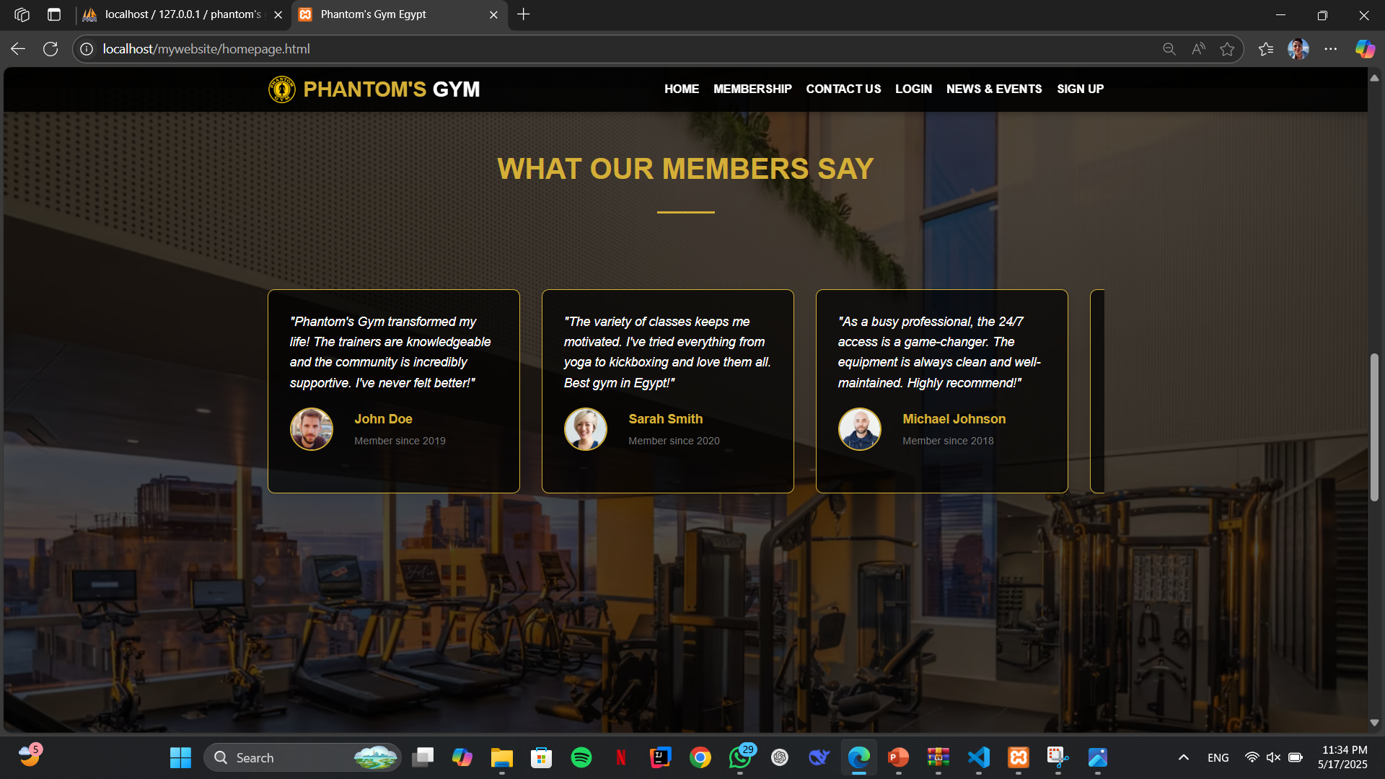
homepage :
Product refers to the good or service you are offering to customers.
What needs does this product fulfil? What frustrations does it address? What makes it compelling to customers such that they will believe they need to have it?
Price
Price is what customers pay for a product or service and it takes into account the cost of production. What is the value of the product or service to customers? Are there established price points for this product or service in the market? How will this price compare with competitors?
Brand
Features
Packaging
Price
Discounts
Bundling deals
Credit terms
Promotion
Promotion is how you will get the word out about your product or service to your target customers.
It includes advertising, public relations, and promotional strategies.
Place
Place refers to how and where your customers will look to see your product or service. It also considers how you will deliver the product or service to them. Will it be in a physical store or online? What will be the distribution channels?
Ads
PR
Social Media
Email
Search Engine
Video
Stores
Website
Online
Marketplace
08

Slide 10
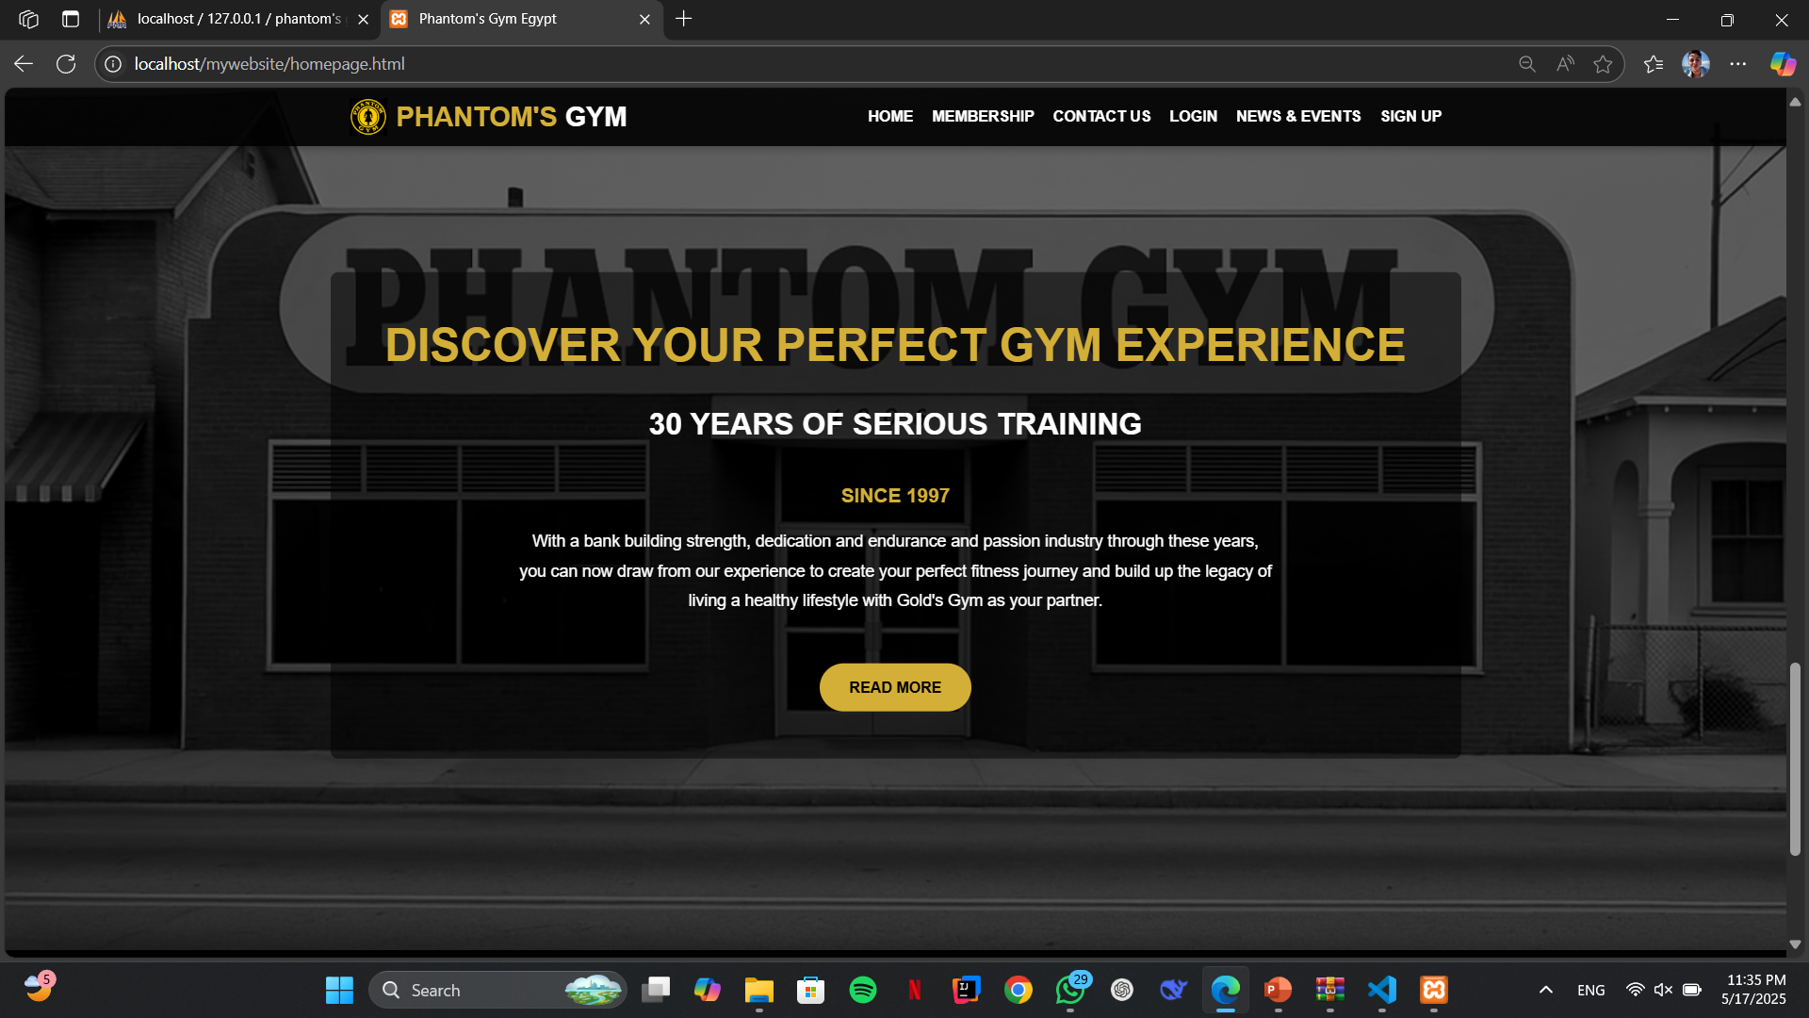
homepage :
Product refers to the good or service you are offering to customers.
What needs does this product fulfil? What frustrations does it address? What makes it compelling to customers such that they will believe they need to have it?
Price
Price is what customers pay for a product or service and it takes into account the cost of production. What is the value of the product or service to customers? Are there established price points for this product or service in the market? How will this price compare with competitors?
Brand
Features
Packaging
Price
Discounts
Bundling deals
Credit terms
Promotion
Promotion is how you will get the word out about your product or service to your target customers.
It includes advertising, public relations, and promotional strategies.
Place
Place refers to how and where your customers will look to see your product or service. It also considers how you will deliver the product or service to them. Will it be in a physical store or online? What will be the distribution channels?
Ads
PR
Social Media
Email
Search Engine
Video
Stores
Website
Online
Marketplace
08

Slide 11
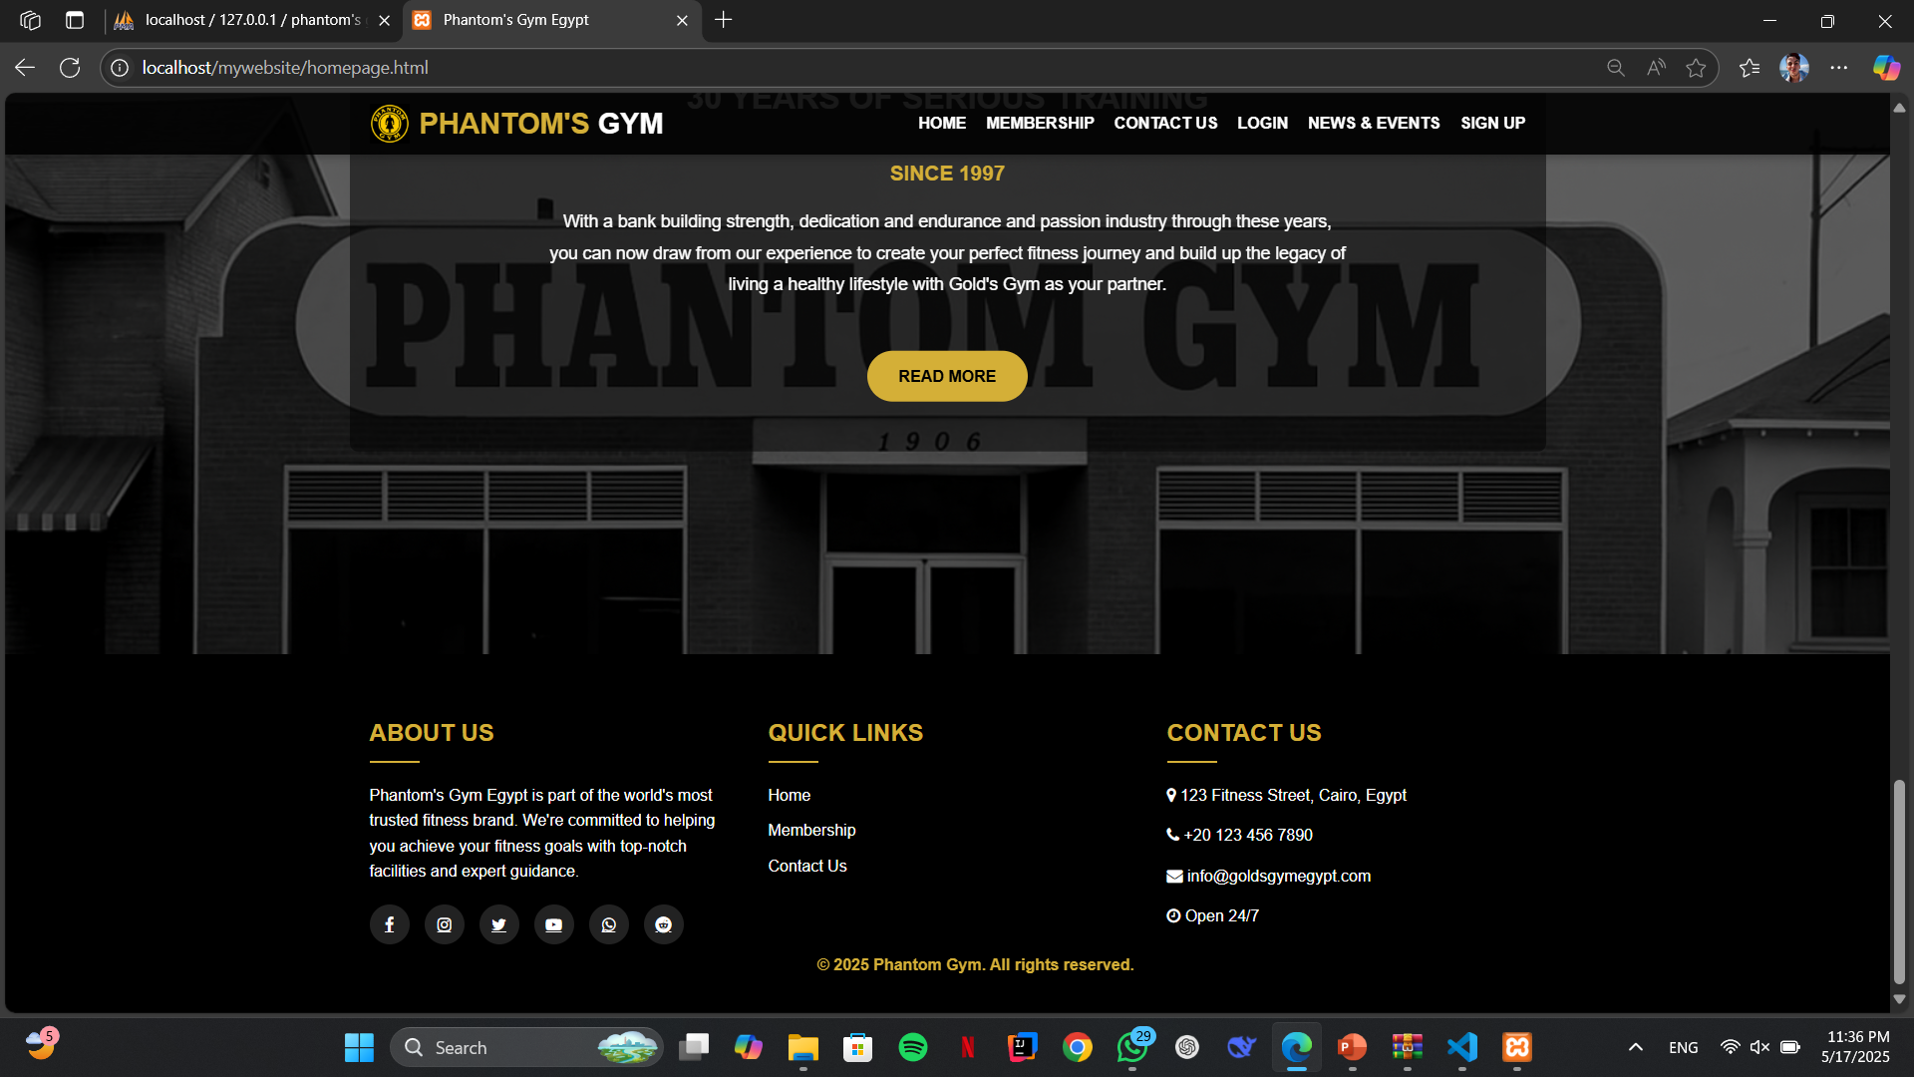
homepage :
Product refers to the good or service you are offering to customers.
What needs does this product fulfil? What frustrations does it address? What makes it compelling to customers such that they will believe they need to have it?
Price
Price is what customers pay for a product or service and it takes into account the cost of production. What is the value of the product or service to customers? Are there established price points for this product or service in the market? How will this price compare with competitors?
Brand
Features
Packaging
Price
Discounts
Bundling deals
Credit terms
Promotion
Promotion is how you will get the word out about your product or service to your target customers.
It includes advertising, public relations, and promotional strategies.
Place
Place refers to how and where your customers will look to see your product or service. It also considers how you will deliver the product or service to them. Will it be in a physical store or online? What will be the distribution channels?
Ads
PR
Social Media
Email
Search Engine
Video
Stores
Website
Online
Marketplace
08

Slide 12
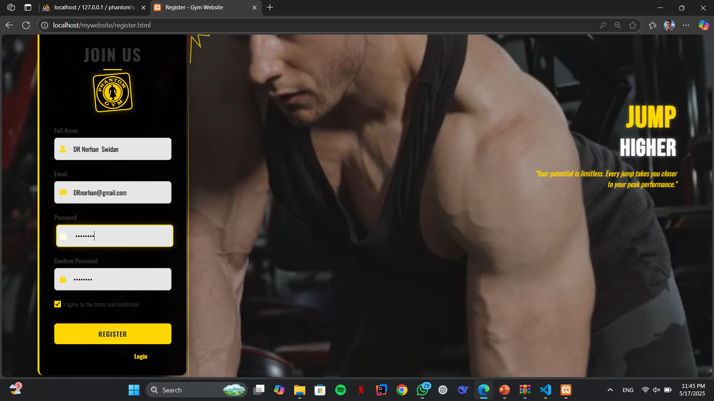
Contact us page :
Product refers to the good or service you are offering to customers.
What needs does this product fulfil? What frustrations does it address? What makes it compelling to customers such that they will believe they need to have it?
Price
Price is what customers pay for a product or service and it takes into account the cost of production. What is the value of the product or service to customers? Are there established price points for this product or service in the market? How will this price compare with competitors?
Brand
Features
Packaging
Price
Discounts
Bundling deals
Credit terms
Promotion
Promotion is how you will get the word out about your product or service to your target customers.
It includes advertising, public relations, and promotional strategies.
Place
Place refers to how and where your customers will look to see your product or service. It also considers how you will deliver the product or service to them. Will it be in a physical store or online? What will be the distribution channels?
Ads
PR
Social Media
Email
Search Engine
Video
Stores
Website
Online
Marketplace
08

Slide 13
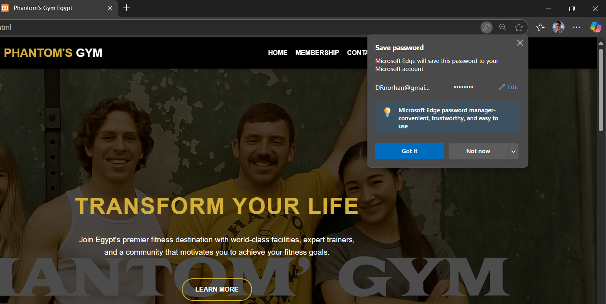
Contact us page :
Product refers to the good or service you are offering to customers.
What needs does this product fulfil? What frustrations does it address? What makes it compelling to customers such that they will believe they need to have it?
Price
Price is what customers pay for a product or service and it takes into account the cost of production. What is the value of the product or service to customers? Are there established price points for this product or service in the market? How will this price compare with competitors?
Brand
Features
Packaging
Price
Discounts
Bundling deals
Credit terms
Promotion
Promotion is how you will get the word out about your product or service to your target customers.
It includes advertising, public relations, and promotional strategies.
Place
Place refers to how and where your customers will look to see your product or service. It also considers how you will deliver the product or service to them. Will it be in a physical store or online? What will be the distribution channels?
Ads
PR
Social Media
Email
Search Engine
Video
Stores
Website
Online
Marketplace
08

Slide 14
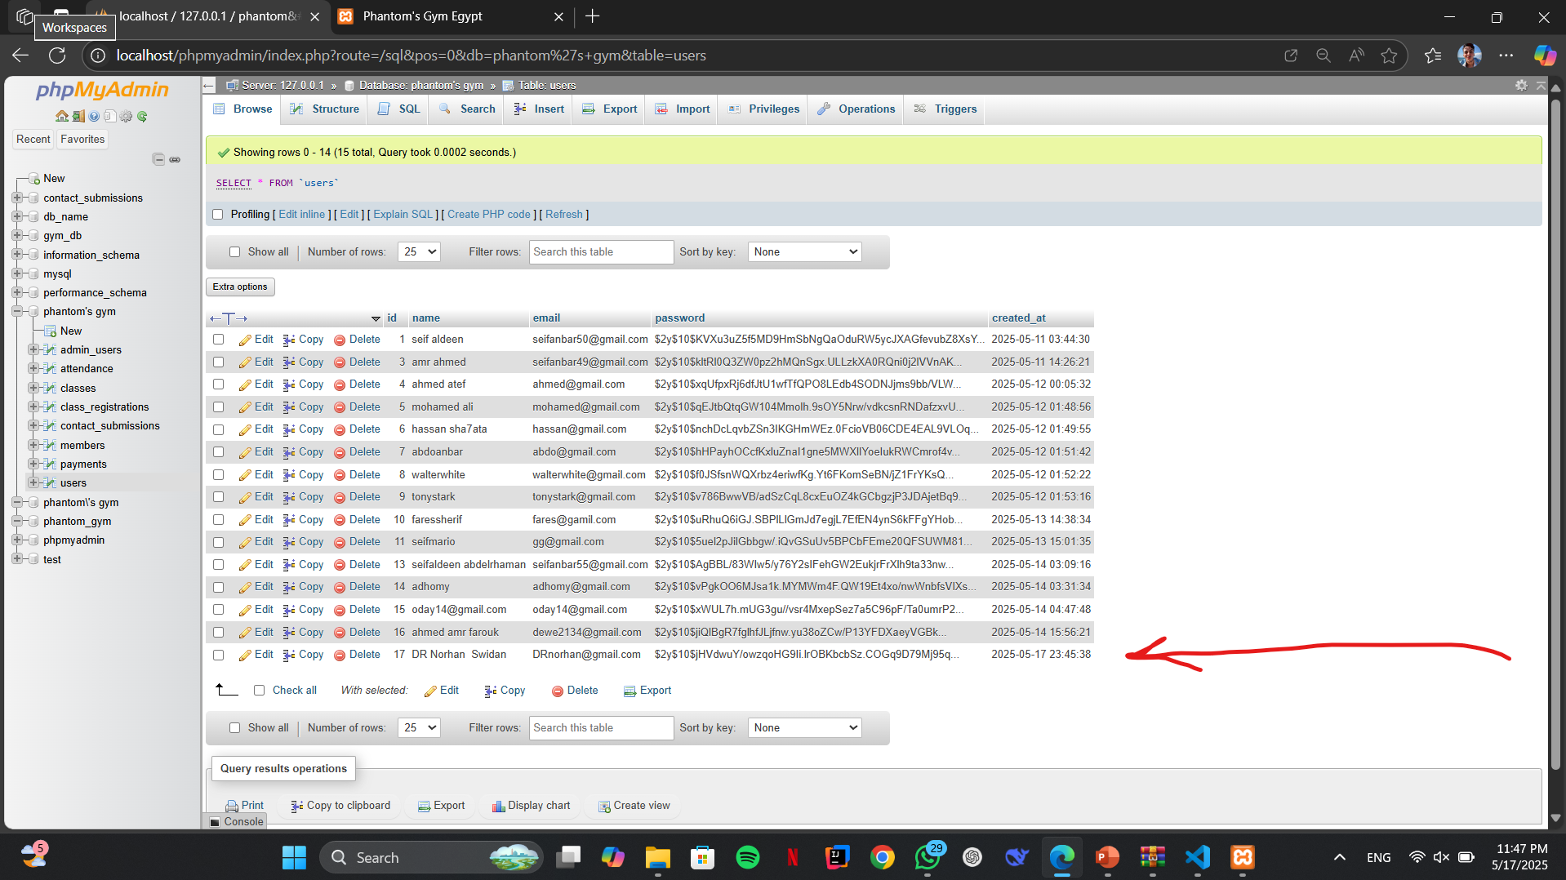
Contact us page :
Product refers to the good or service you are offering to customers.
What needs does this product fulfil? What frustrations does it address? What makes it compelling to customers such that they will believe they need to have it?
Price
Price is what customers pay for a product or service and it takes into account the cost of production. What is the value of the product or service to customers? Are there established price points for this product or service in the market? How will this price compare with competitors?
Brand
Features
Packaging
Price
Discounts
Bundling deals
Credit terms
Promotion
Promotion is how you will get the word out about your product or service to your target customers.
It includes advertising, public relations, and promotional strategies.
Place
Place refers to how and where your customers will look to see your product or service. It also considers how you will deliver the product or service to them. Will it be in a physical store or online? What will be the distribution channels?
Ads
PR
Social Media
Email
Search Engine
Video
Stores
Website
Online
Marketplace
08

Slide 15
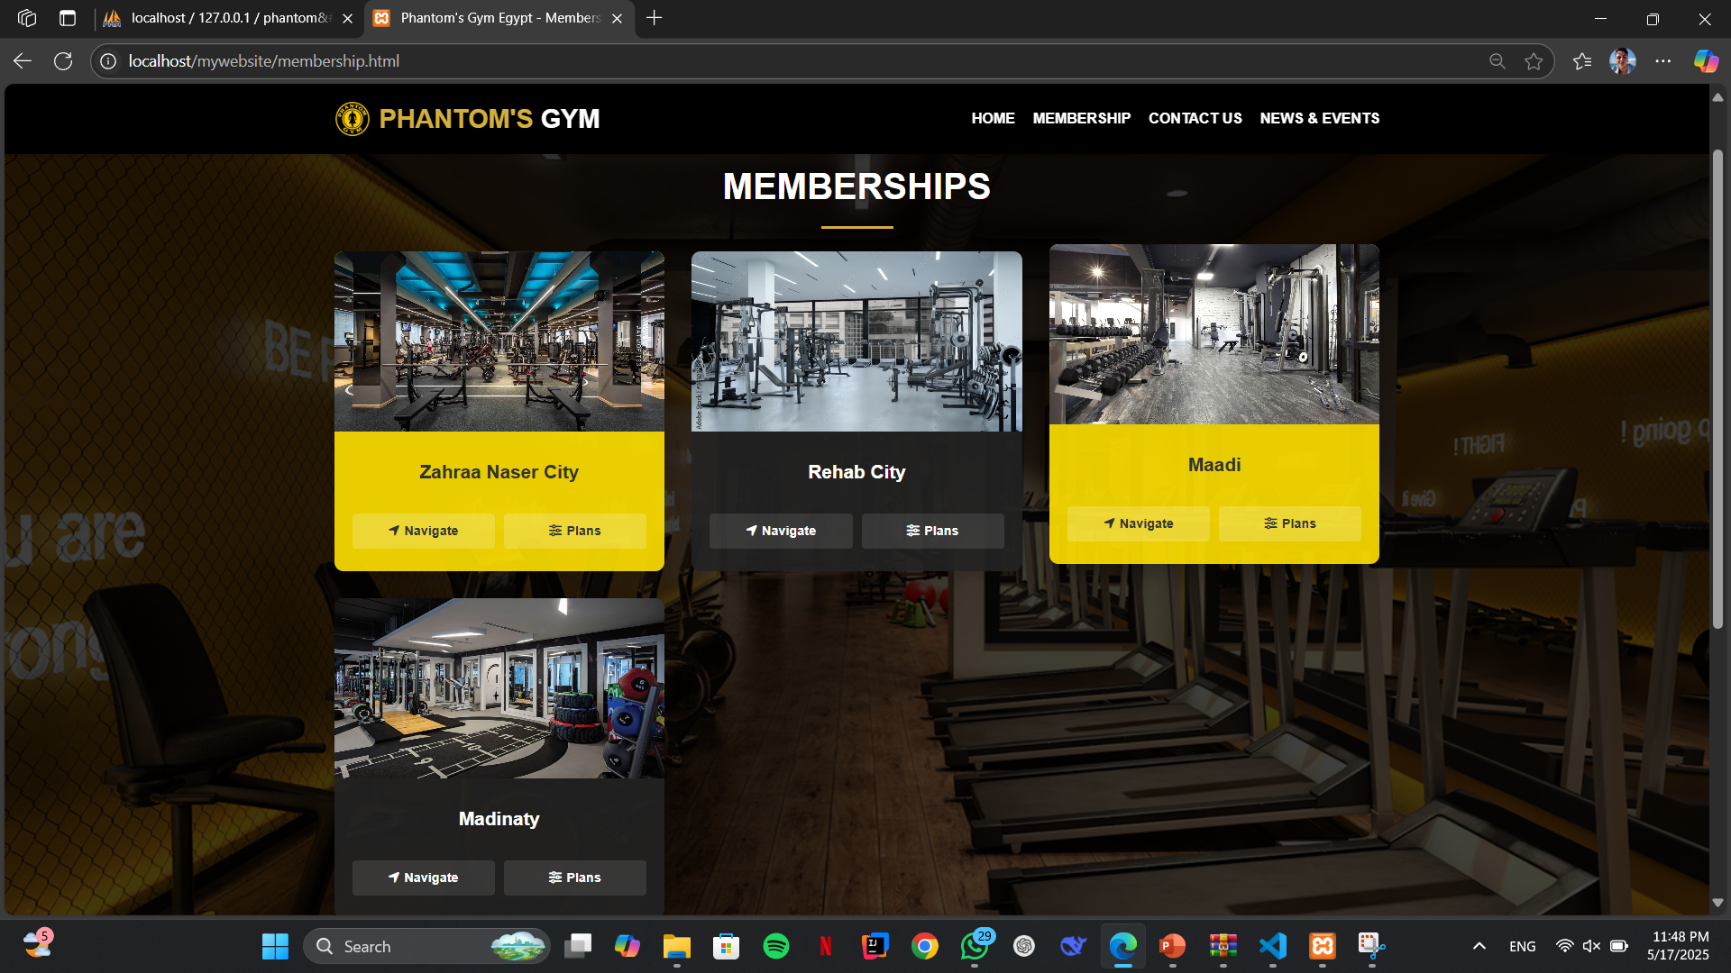
Membership page :
Product refers to the good or service you are offering to customers.
What needs does this product fulfil? What frustrations does it address? What makes it compelling to customers such that they will believe they need to have it?
Price
Price is what customers pay for a product or service and it takes into account the cost of production. What is the value of the product or service to customers? Are there established price points for this product or service in the market? How will this price compare with competitors?
Brand
Features
Packaging
Price
Discounts
Bundling deals
Credit terms
Promotion
Promotion is how you will get the word out about your product or service to your target customers.
It includes advertising, public relations, and promotional strategies.
Place
Place refers to how and where your customers will look to see your product or service. It also considers how you will deliver the product or service to them. Will it be in a physical store or online? What will be the distribution channels?
Ads
PR
Social Media
Email
Search Engine
Video
Stores
Website
Online
Marketplace
08

Slide 16
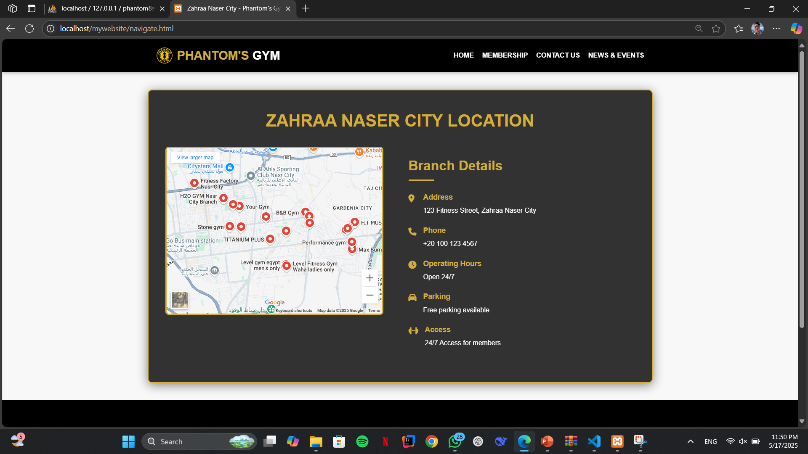
Membership ( navigate ) page
Product refers to the good or service you are offering to customers.
What needs does this product fulfil? What frustrations does it address? What makes it compelling to customers such that they will believe they need to have it?
Price
Price is what customers pay for a product or service and it takes into account the cost of production. What is the value of the product or service to customers? Are there established price points for this product or service in the market? How will this price compare with competitors?
Brand
Features
Packaging
Price
Discounts
Bundling deals
Credit terms
Promotion
Promotion is how you will get the word out about your product or service to your target customers.
It includes advertising, public relations, and promotional strategies.
Place
Place refers to how and where your customers will look to see your product or service. It also considers how you will deliver the product or service to them. Will it be in a physical store or online? What will be the distribution channels?
Ads
PR
Social Media
Email
Search Engine
Video
Stores
Website
Online
Marketplace
08

Slide 17
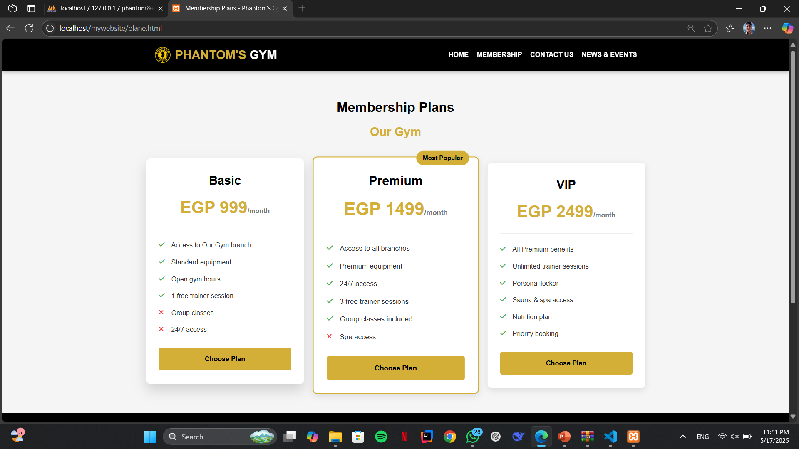
Membership (plans) :
Product refers to the good or service you are offering to customers.
What needs does this product fulfil? What frustrations does it address? What makes it compelling to customers such that they will believe they need to have it?
Price
Price is what customers pay for a product or service and it takes into account the cost of production. What is the value of the product or service to customers? Are there established price points for this product or service in the market? How will this price compare with competitors?
Brand
Features
Packaging
Price
Discounts
Bundling deals
Credit terms
Promotion
Promotion is how you will get the word out about your product or service to your target customers.
It includes advertising, public relations, and promotional strategies.
Place
Place refers to how and where your customers will look to see your product or service. It also considers how you will deliver the product or service to them. Will it be in a physical store or online? What will be the distribution channels?
Ads
PR
Social Media
Email
Search Engine
Video
Stores
Website
Online
Marketplace
08

Slide 18
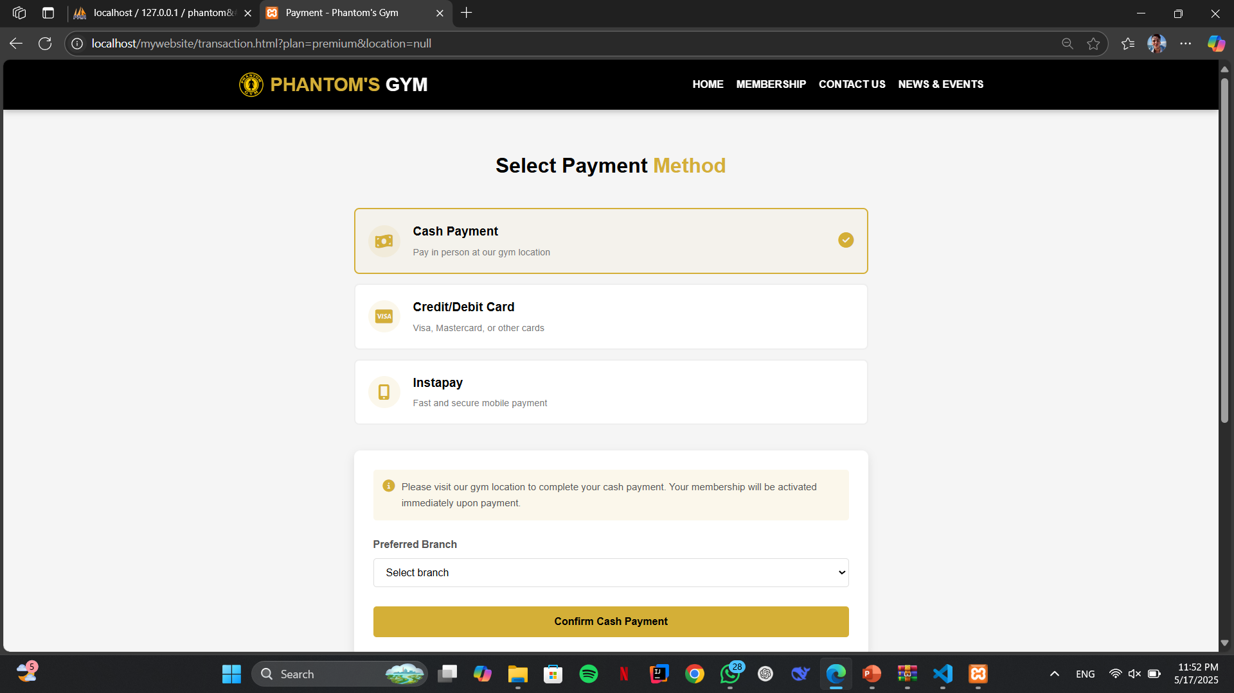
Payment methods page :
Product refers to the good or service you are offering to customers.
What needs does this product fulfil? What frustrations does it address? What makes it compelling to customers such that they will believe they need to have it?
Price
Price is what customers pay for a product or service and it takes into account the cost of production. What is the value of the product or service to customers? Are there established price points for this product or service in the market? How will this price compare with competitors?
Brand
Features
Packaging
Price
Discounts
Bundling deals
Credit terms
Promotion
Promotion is how you will get the word out about your product or service to your target customers.
It includes advertising, public relations, and promotional strategies.
Place
Place refers to how and where your customers will look to see your product or service. It also considers how you will deliver the product or service to them. Will it be in a physical store or online? What will be the distribution channels?
Ads
PR
Social Media
Email
Search Engine
Video
Stores
Website
Online
Marketplace
08

Slide 19
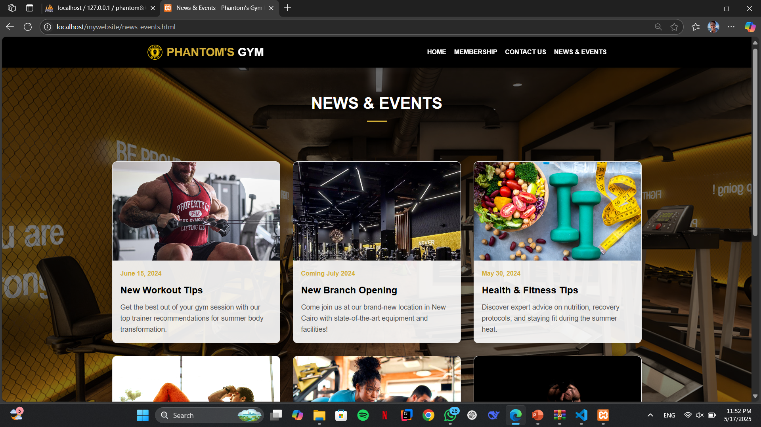
News & events page :
Product refers to the good or service you are offering to customers.
What needs does this product fulfil? What frustrations does it address? What makes it compelling to customers such that they will believe they need to have it?
Price
Price is what customers pay for a product or service and it takes into account the cost of production. What is the value of the product or service to customers? Are there established price points for this product or service in the market? How will this price compare with competitors?
Brand
Features
Packaging
Price
Discounts
Bundling deals
Credit terms
Promotion
Promotion is how you will get the word out about your product or service to your target customers.
It includes advertising, public relations, and promotional strategies.
Place
Place refers to how and where your customers will look to see your product or service. It also considers how you will deliver the product or service to them. Will it be in a physical store or online? What will be the distribution channels?
Ads
PR
Social Media
Email
Search Engine
Video
Stores
Website
Online
Marketplace
08

Slide 20
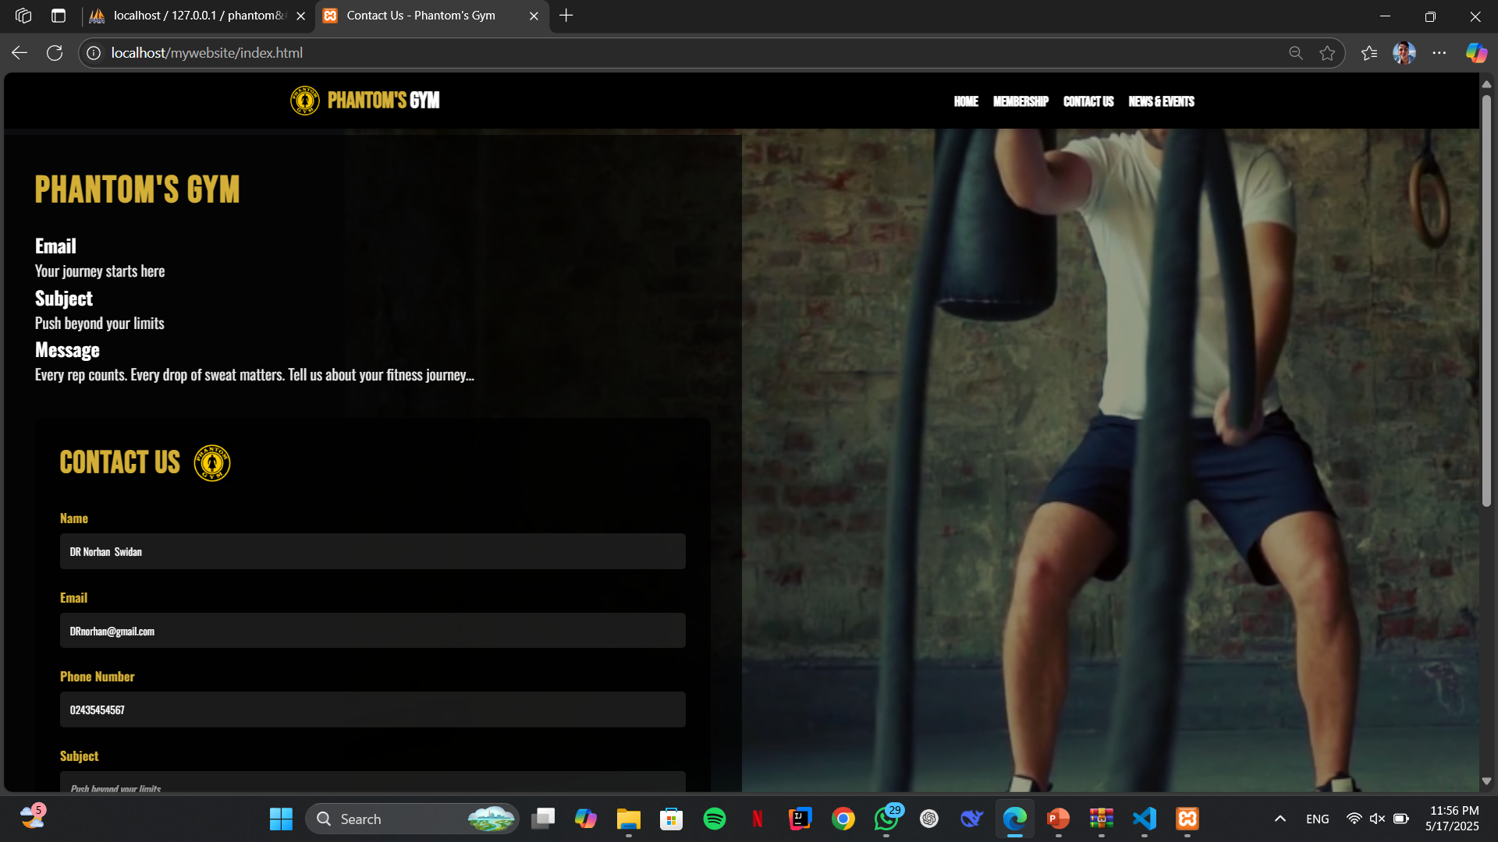
Contact us page :
Product refers to the good or service you are offering to customers.
What needs does this product fulfil? What frustrations does it address? What makes it compelling to customers such that they will believe they need to have it?
Price
Price is what customers pay for a product or service and it takes into account the cost of production. What is the value of the product or service to customers? Are there established price points for this product or service in the market? How will this price compare with competitors?
Brand
Features
Packaging
Price
Discounts
Bundling deals
Credit terms
Promotion
Promotion is how you will get the word out about your product or service to your target customers.
It includes advertising, public relations, and promotional strategies.
Place
Place refers to how and where your customers will look to see your product or service. It also considers how you will deliver the product or service to them. Will it be in a physical store or online? What will be the distribution channels?
Ads
PR
Social Media
Email
Search Engine
Video
Stores
Website
Online
Marketplace
08

Slide 21
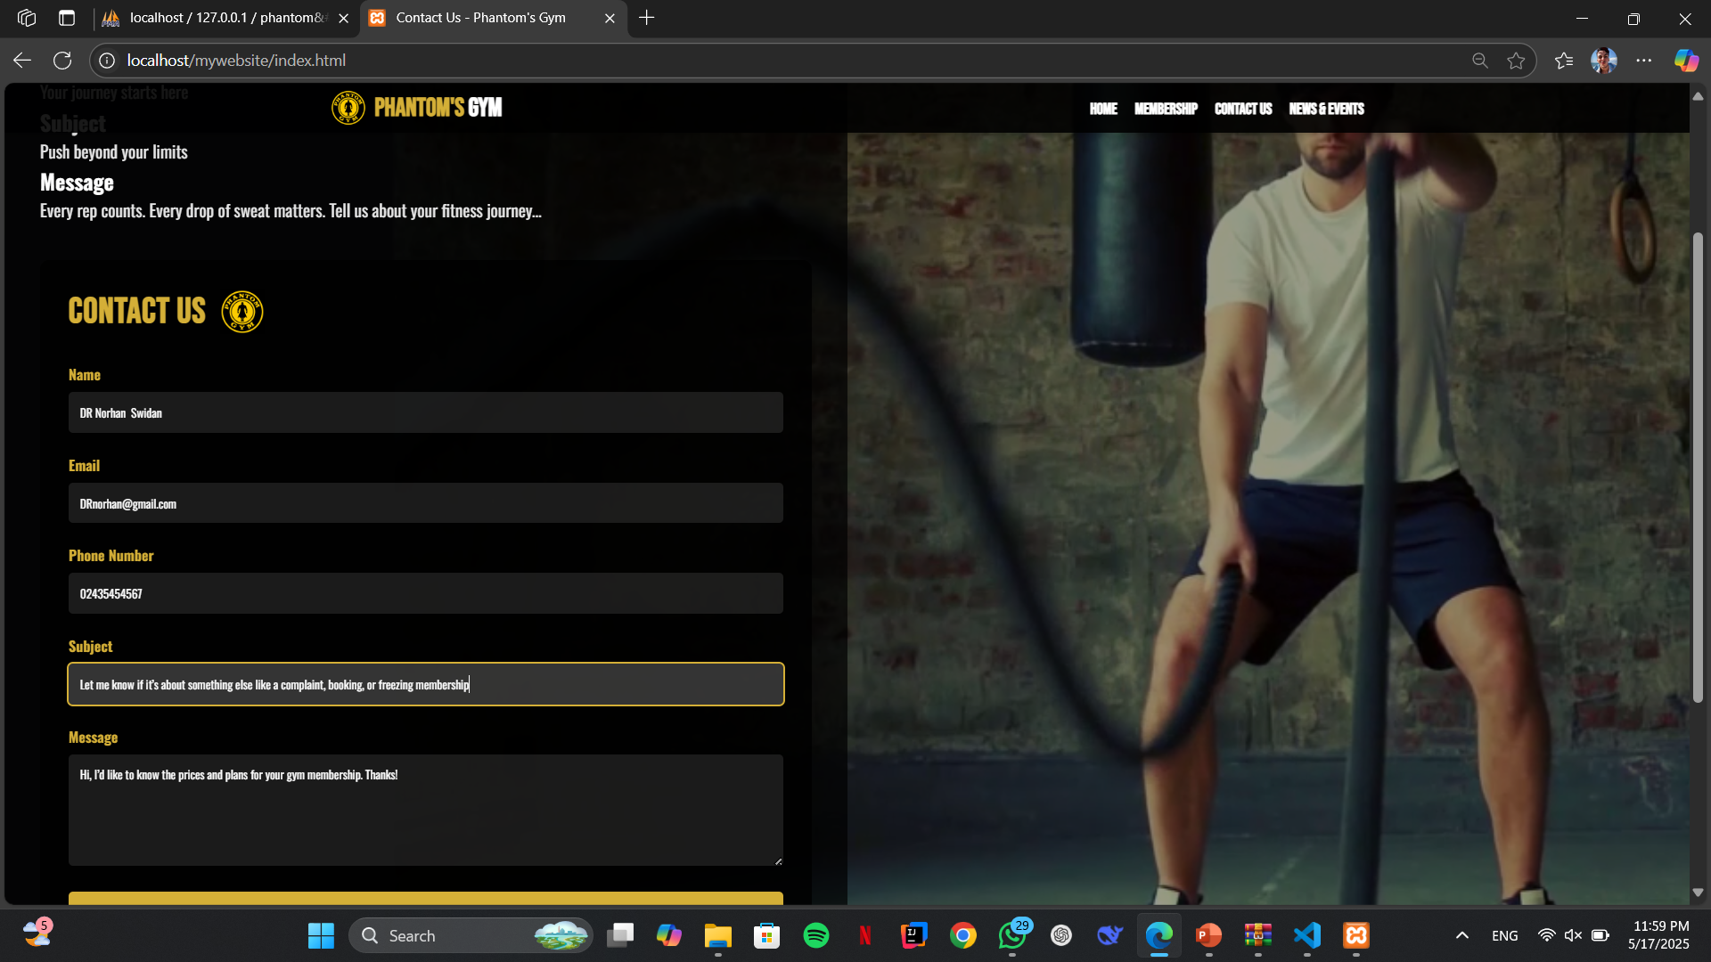
Contact us page :
Product refers to the good or service you are offering to customers.
What needs does this product fulfil? What frustrations does it address? What makes it compelling to customers such that they will believe they need to have it?
Price
Price is what customers pay for a product or service and it takes into account the cost of production. What is the value of the product or service to customers? Are there established price points for this product or service in the market? How will this price compare with competitors?
Brand
Features
Packaging
Price
Discounts
Bundling deals
Credit terms
Promotion
Promotion is how you will get the word out about your product or service to your target customers.
It includes advertising, public relations, and promotional strategies.
Place
Place refers to how and where your customers will look to see your product or service. It also considers how you will deliver the product or service to them. Will it be in a physical store or online? What will be the distribution channels?
Ads
PR
Social Media
Email
Search Engine
Video
Stores
Website
Online
Marketplace
08

Slide 22
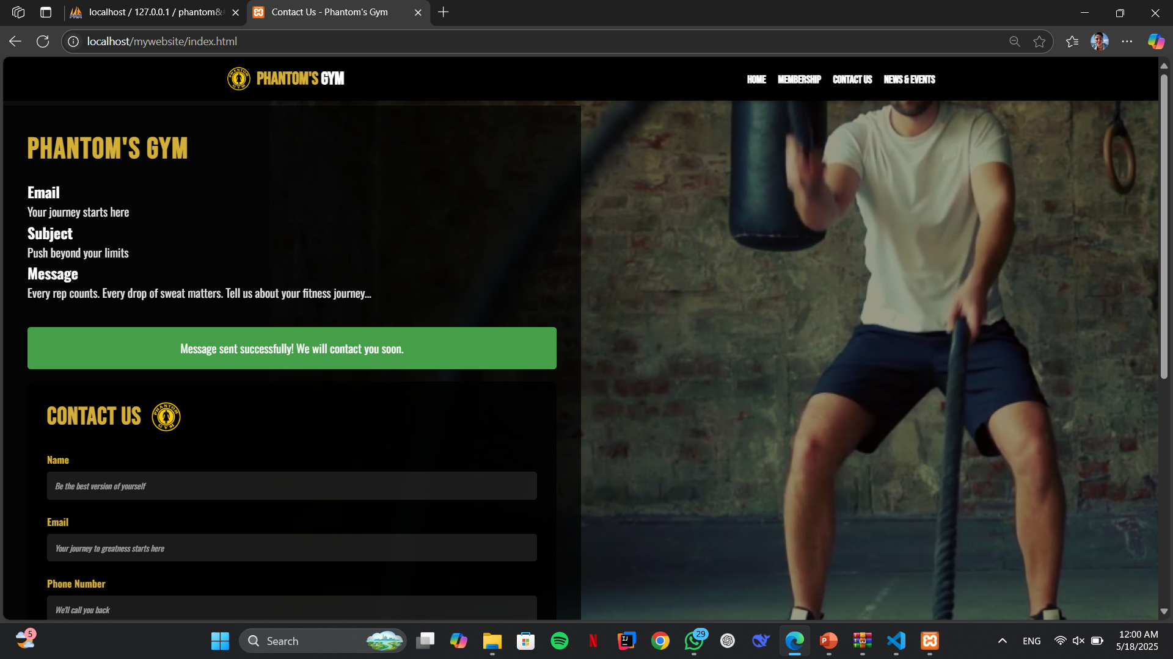
Contact us page :
Product refers to the good or service you are offering to customers.
What needs does this product fulfil? What frustrations does it address? What makes it compelling to customers such that they will believe they need to have it?
Price
Price is what customers pay for a product or service and it takes into account the cost of production. What is the value of the product or service to customers? Are there established price points for this product or service in the market? How will this price compare with competitors?
Brand
Features
Packaging
Price
Discounts
Bundling deals
Credit terms
Promotion
Promotion is how you will get the word out about your product or service to your target customers.
It includes advertising, public relations, and promotional strategies.
Place
Place refers to how and where your customers will look to see your product or service. It also considers how you will deliver the product or service to them. Will it be in a physical store or online? What will be the distribution channels?
Ads
PR
Social Media
Email
Search Engine
Video
Stores
Website
Online
Marketplace
08

Slide 23
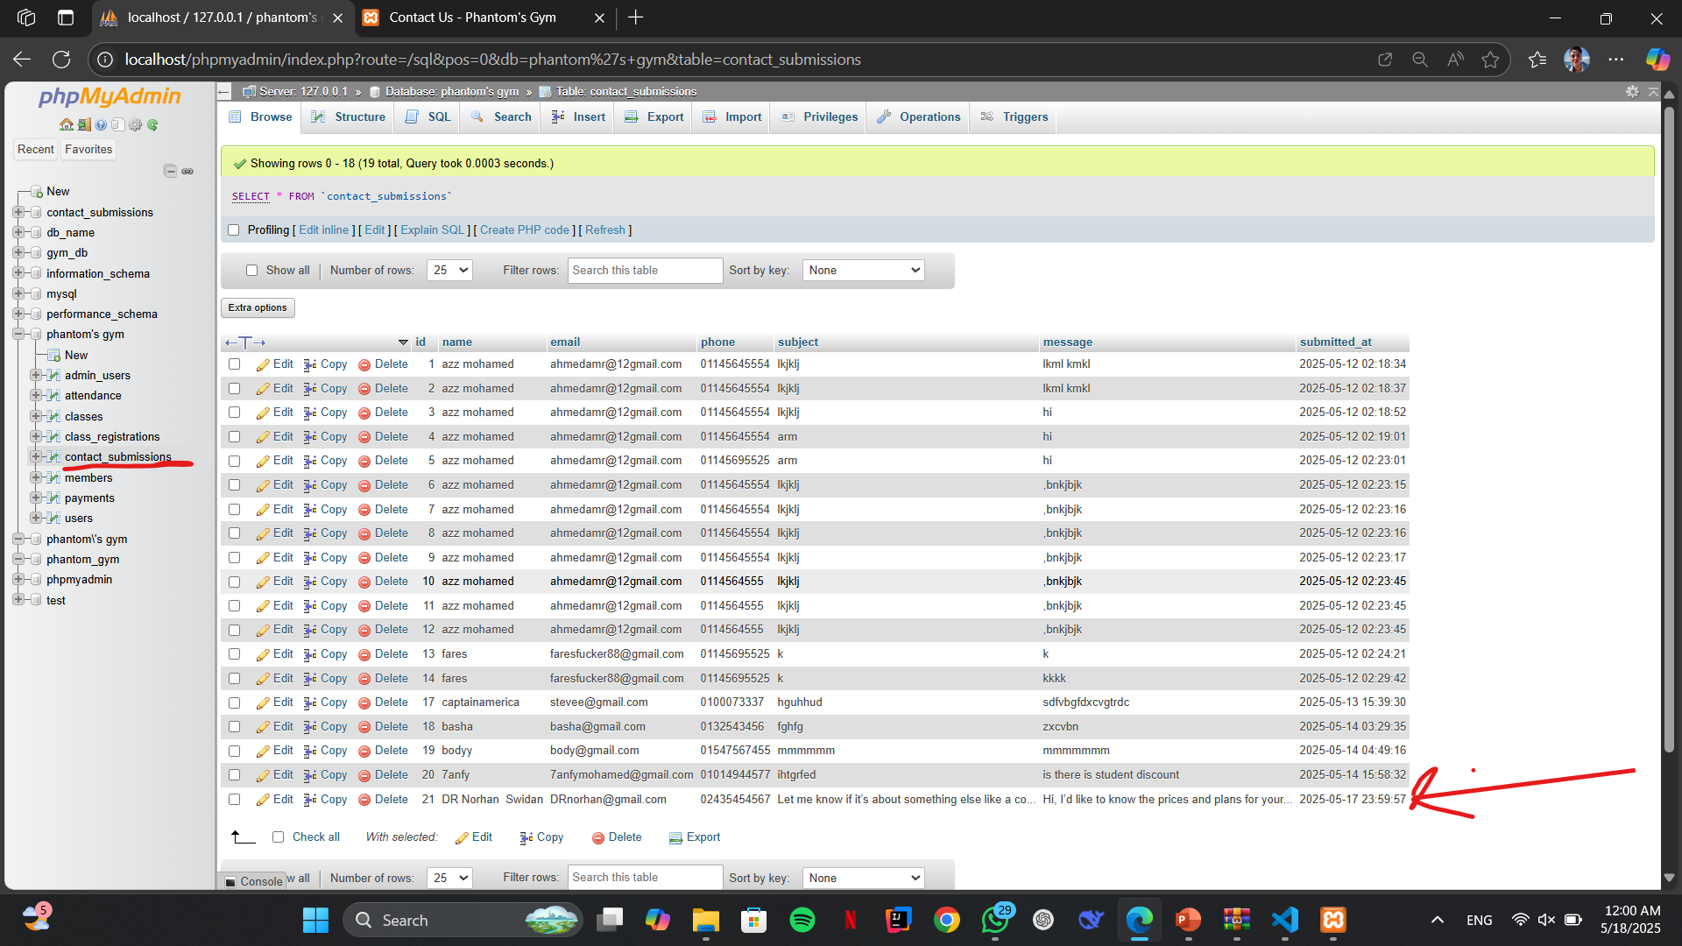
PHP contact us Database :
Product refers to the good or service you are offering to customers.
What needs does this product fulfil? What frustrations does it address? What makes it compelling to customers such that they will believe they need to have it?
Price
Price is what customers pay for a product or service and it takes into account the cost of production. What is the value of the product or service to customers? Are there established price points for this product or service in the market? How will this price compare with competitors?
Brand
Features
Packaging
Price
Discounts
Bundling deals
Credit terms
Promotion
Promotion is how you will get the word out about your product or service to your target customers.
It includes advertising, public relations, and promotional strategies.
Place
Place refers to how and where your customers will look to see your product or service. It also considers how you will deliver the product or service to them. Will it be in a physical store or online? What will be the distribution channels?
Ads
PR
Social Media
Email
Search Engine
Video
Stores
Website
Online
Marketplace
08

Slide 24
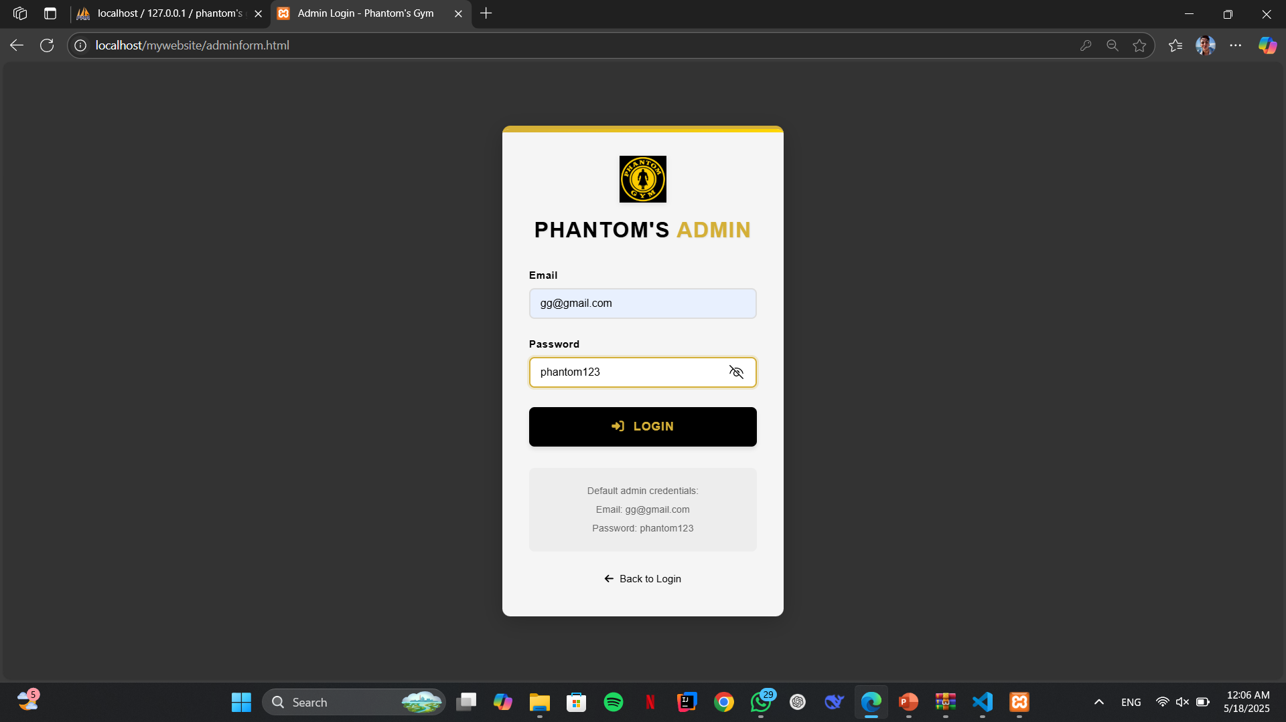
Admin login page :
Product refers to the good or service you are offering to customers.
What needs does this product fulfil? What frustrations does it address? What makes it compelling to customers such that they will believe they need to have it?
Price
Price is what customers pay for a product or service and it takes into account the cost of production. What is the value of the product or service to customers? Are there established price points for this product or service in the market? How will this price compare with competitors?
Brand
Features
Packaging
Price
Discounts
Bundling deals
Credit terms
Promotion
Promotion is how you will get the word out about your product or service to your target customers.
It includes advertising, public relations, and promotional strategies.
Place
Place refers to how and where your customers will look to see your product or service. It also considers how you will deliver the product or service to them. Will it be in a physical store or online? What will be the distribution channels?
Ads
PR
Social Media
Email
Search Engine
Video
Stores
Website
Online
Marketplace
08

Slide 25
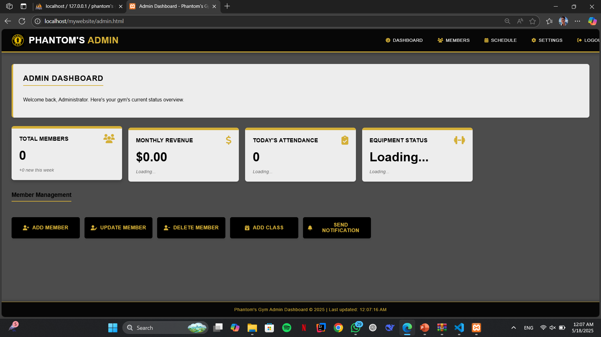
admin page :
Product refers to the good or service you are offering to customers.
What needs does this product fulfil? What frustrations does it address? What makes it compelling to customers such that they will believe they need to have it?
Price
Price is what customers pay for a product or service and it takes into account the cost of production. What is the value of the product or service to customers? Are there established price points for this product or service in the market? How will this price compare with competitors?
Brand
Features
Packaging
Price
Discounts
Bundling deals
Credit terms
Promotion
Promotion is how you will get the word out about your product or service to your target customers.
It includes advertising, public relations, and promotional strategies.
Place
Place refers to how and where your customers will look to see your product or service. It also considers how you will deliver the product or service to them. Will it be in a physical store or online? What will be the distribution channels?
Ads
PR
Social Media
Email
Search Engine
Video
Stores
Website
Online
Marketplace
08

Slide 26
04
What makes our website special:
Phantom Gym is a modern online platform designed to meet the needs of fitness enthusiasts. It offers:
1. Strong Brand Identity
The name Phantom's Gym Egypt sounds unique and bold, giving it a memorable and powerful identity.
The logo and hero banner emphasize transformation and strength, which resonates well with fitness enthusiasts.
2. Compelling Hero Section
"TRANSFORM YOUR LIFE" is a powerful headline that speaks directly to personal change.
You clearly explain your value: world-class facilities, expert trainers, and a supportive community.
3. Social Proof & Credibility
Testimonials from long-time members (since 2018–2021) add authenticity and trust.
Including names and real photos (even if stock) builds emotional connection.

Slide 27
04
4. Visual Highlights of Features
Cards for State-of-the-Art Equipment, Expert Trainers, and Diverse Classes make benefits easy to digest.
Accompanied by relevant images to keep the visitor visually engaged.
5. Legacy & Experience
The “Discover” section emphasizing 30 years of serious training and a history since 1997 provides a sense of trust and legacy.
Few gyms highlight history this clearly — it adds depth.
6. Full Social Media Integration
Facebook, Instagram, YouTube, Reddit, WhatsApp, and Twitter icons offer full omnichannel reach.
Shows you're accessible across platforms, modern, and engaged.
7. Responsive & Mobile-Friendly Touches
Mobile menu and JavaScript enhancements show awareness of mobile usability.
Scroll-based header adjustment adds a sleek, interactive feel.

Slide 28
04
Conclusion :
This project, Phantom’s Gym Egypt, demonstrates a well-rounded application of core web programming principles — combining HTML, CSS, JavaScript, and PHP to build a visually appealing, functional, and user-oriented website.
Responsive Layout & User Experience
Clear navigation, responsive header behavior, and a mobile-friendly menu show awareness of front-end usability.
JavaScript is used effectively to enhance interactivity (e.g., scroll effects, menu toggle).
Semantic HTML Structure
Use of proper tags (<header>, <section>, <footer>) improves accessibility and maintainability.
Well-structured content allows for easy extension and future improvements.

Slide 29
04
Conclusion :
External Styling & Modern UI Design
External CSS via homepage.css separates design from structure, following best practices.
Use of Font Awesome and modern layout elements creates a clean, professional look.
Content-Rich & Feature-Oriented
Sections like testimonials, features, and a "discover" area add depth and real-world value to the design.
Social media integration and contact details show awareness of real business needs.

